Slide 1
CSF 407 – ARTIFICIAL INTELLIGENCE
OPTIMAL HEAT EXCHANGER DESIGN
USING
GENETIC ALGORITHMS
GROUP ID - 60
TEAM MEMBERS ID | NAMES
1. 2020A1PS0765H (Leader) | Krishna Shankar
2. 2020A1PS2385H | Zakia Firdous Munshi
3. 2020A4PS1956H | Koushik Vennelakanti
4. 2020A8PS1468H | Bharath Potluri

Slide 2
INTRODUCTION
A heat exchanger is a device that is used for effective transfer of heat from one fluid(gas or liquid) to another. It has widespread application in chemical engineering and is used in different industries
Due to the widespread usage of heat exchangers in industrial processes, both designers and users place a high priority on reducing their cost.
Here, we will be specifically studying optimization of the design of shell and tube type heat exchangers.
It has a bundle of tubes within a cylindrical shell and the two fluids (shell side fluid and tube side fluid) flow through the shell and the tubes respectively, separated by the tube wall. The figures in the next slide describe the design of a shell and tube heat exchanger.

Slide 3
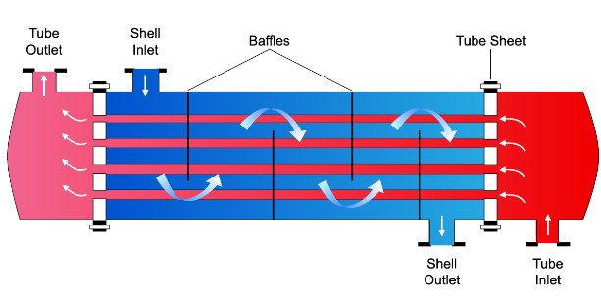
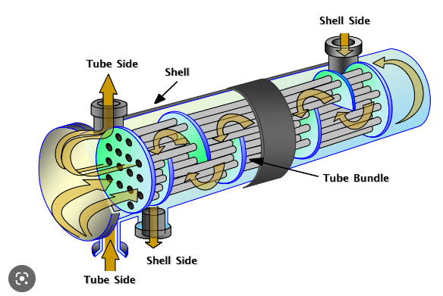
Shell and Tube Heat Exchanger

Slide 4
The process for designing shell and tube heat exchangers optimally is suggested in this study. It makes use of a genetic algorithm to reduce the equipment's overall cost, which includes the capital investment and the total of discounted yearly energy costs associated to pumping.
In the literature we see that there is significant cost savings when designed using GA over conventional methods.
Genetic algorithms are a class of optimization algorithms that are based on the principles of natural selection and genetics. They are inspired by the process of evolution in nature, and they work by creating a population of potential solutions and iteratively refining these solutions over multiple generations. At each iteration, the algorithm evaluates the fitness of each solution in the population, selects the most fit individuals, and applies genetic operators such as mutation and crossover to create new candidate solutions.

Slide 5
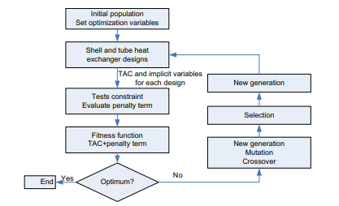
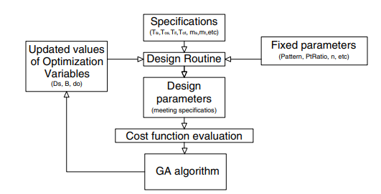
In the context of heat exchanger design, genetic algorithms can be used to optimize a wide range of design parameters, such as the heat transfer surface area, the flow rate of the fluids, and the geometric configuration of the exchanger. The algorithm works by defining a fitness function that quantifies the performance of each potential solution in the population. This function can be based on a variety of criteria, such as the overall heat transfer rate, the pressure drop across the exchanger, or the cost of materials and construction.
By leveraging the principles of natural selection and genetics, these algorithms can efficiently explore a large search space, handle multiple objectives simultaneously, and converge on an optimal design that meets the requirements of the application.

Slide 6
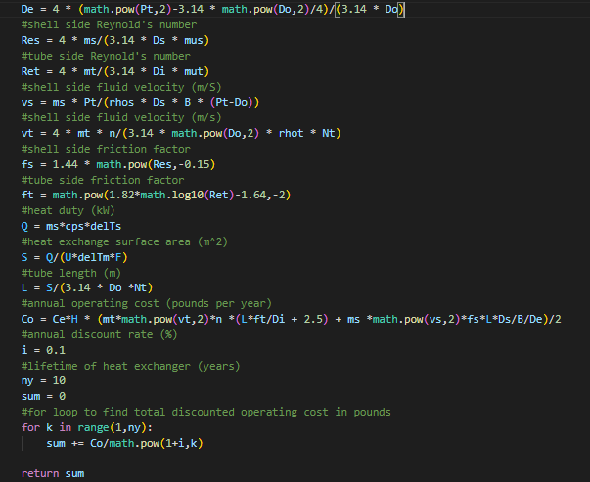
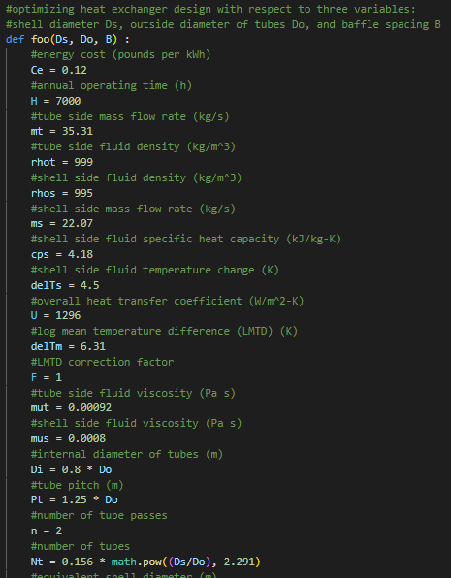
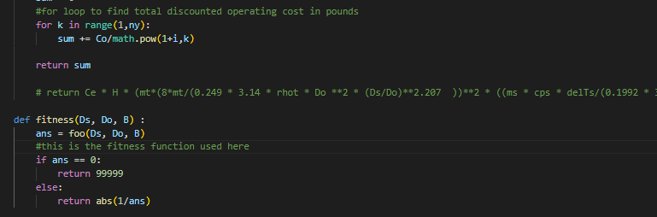
The code

